Slide 1


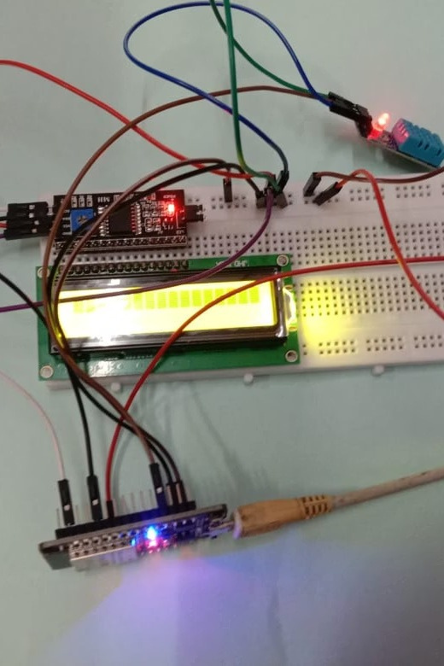
Air quality monitoring system using esp32 and blynk

Slide 2

Objective: Remote Environmental Monitoring
Ourgoalis toconstruct an Internet of Things(IoT)systemcapableof
measuring ambient temperature and humidity.This system willleverage an ESP32 microcontroller and a DHT sensor to capture real-time environmental
data, which will then be visually presented through intuitive mobile and web
dashboards powered by the Blynk platform.

Slide 3


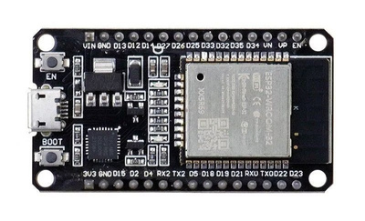
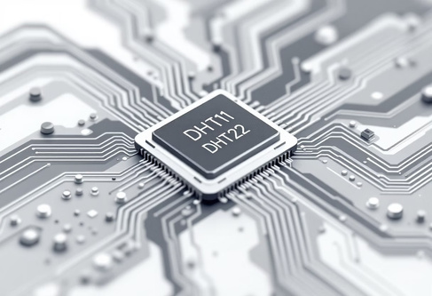
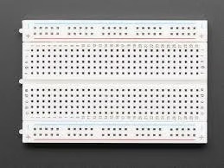
Essential Hardware Components
ESP32DevelopmentBoard
DHT11orDHT22Sensor
Breadboard & Jumper Wires
Thecoreofour system,providingWi- Fi connectivity and processing power.
Acost-effectivedigital sensorfor
accurate temperature and humidity readings.
For prototyping and easily
connecting components without soldering.

Slide 4

Software & Cloud Infrastructure
Arduino IDE (or PlatformIO)
Blynk IoT Platform
Wi-Fi Credentials
Our chosenenvironment forwriting and uploading code to the ESP32.
Apowerful platformfor creating dashboards, managing devices, and data visualization. We'll set up a template and generate an authentication token here.
Secure networkaccess for your
ESP32 to communicate with the Blynk cloud.

Slide 5
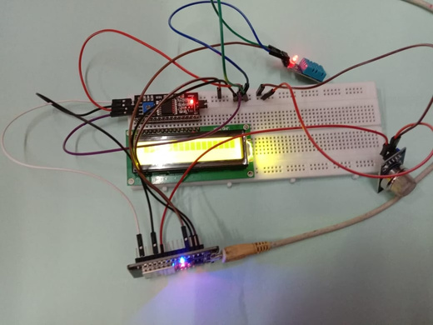
Circuit Connection Guide
01
Connect DHT Data Pin
02
Power the DHT Sensor
Wire thedata pinof your DHT sensor to an available GPIO pin on the ESP32 (e.g., GPIO 27). This pin will transmit
the sensor readings.
Connect the Vccpinofthe DHT
sensor to the 3.3V output pin on the ESP32.
03
Ground the Circuit
Connectthe GNDpin ofthe DHT sensor to a GND pin on the ESP32,
completing the power circuit.

Slide 6

Data Flow Workflow
1. ESP32 Connects to Wi-Fi
2. Reads Sensor Values
TheESP32initiatesaconnectiontothe configured wireless network.
Periodically, the ESP32queriesthe DHT sensor for
temperature and humidity data.
3. Validates Readings
4. Sends Data to Blynk
Thesystemchecksifthesensor data is valid and not erroneous.
Validateddataistransmittedtothe Blynk dashboard using
Blynk.virtualWrite().

Slide 7


Core Code Snippet
Thiscodeblockdemonstrateshow toread sensordata and send it to Blynk's
virtualpins.Itincludesbasicerror checking toensure only valid data is transmitted.
float t = dht.readTemperature(); float h = dht.readHumidity();
if (!isnan(t) && !isnan(h)) {
Blynk.virtualWrite(V0, t); // Send temperature to Virtual Pin V0
Blynk.virtualWrite(V1, h); // Send humidity to Virtual Pin V1
}

Slide 8
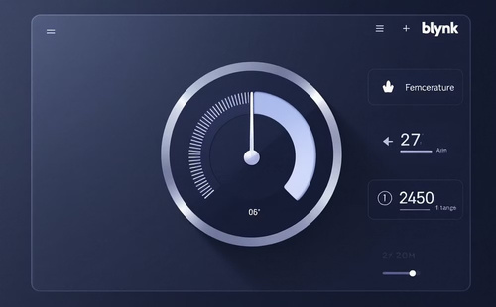
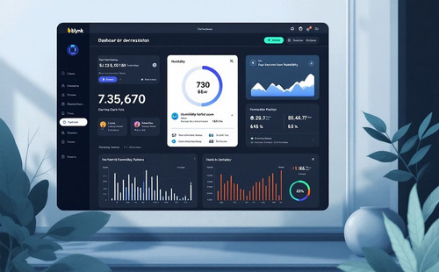

Blynk Dashboard & Widgets
Visualize your environmental datawithinteractivewidgetsontheBlynkplatform.Virtual pins act as communication channels
between your ESP32andthe dashboard.
Virtual Pin V0: Temperature Gauge
Virtual Pin V1: Humidity Gauge
Real-time Updates
Presents current humidity levels, complementing the temperature display.
Experience immediate data visualization as your sensor reports new values.
Displays real-time temperature readings in an easy-to-read gauge format.

Slide 9

Benefits & Diverse Use Cases
Remote Environment
Threshold Alerts
Configure notificationsto be
Monitoring
Ideal forgreenhouses, laboratories, or server rooms where precise climate control is crucial.
triggered when temperature or humidity exceeds predefined limits, preventing potential
damage.
Data Logging & Analytics
Collecthistorical dataforanalysis,pattern identification, and informed
decision-making regarding environmental conditions.

Slide 10

Challenges & Best Practices
Network Reliability
Sensor Calibration & Accuracy
Limit Update Rate
Ensureastable Wi-Fi connection for
Avoidexceedingcloud service limits
uninterrupted data flow. Intermittent connectivity can lead to data loss.
Periodicallyverifysensorreadings against a reference to maintain accuracy, especially in critical
applications.
by setting a reasonable data transmission frequency. Too frequent updates can lead to service interruptions.

Slide 11

Project Team
Shubrat Chaudhary
Shubham Singh
Shubhi Singh Shubhi Sharma

